Slide 1

Financial Sentiment analysis
Dataset link :
https://www.kaggle.com/datasets/sbhatti/financial-sentiment-analysis

Slide 2


GOAL :
The following data is intended for advancing financial sentiment analysis research. It's two datasets (FiQA, Financial Phrase Bank) combined into one easy-to-use CSV file. It provides financial sentences with sentiment labels.

Slide 3
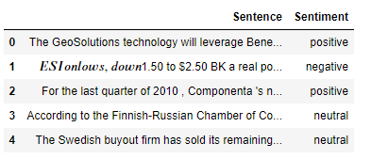
VARIABLES INVOLVED :
Sentence : Statements made
Sentiment : Emotions contained in each sentence (positive, neutral, negative)

Slide 4
MY LEARNINGS :
Sentiment analysis
Building word cloud
Building predictive models
Logistic regression model
Naïve Bayes' Model
SVM Model

Slide 5
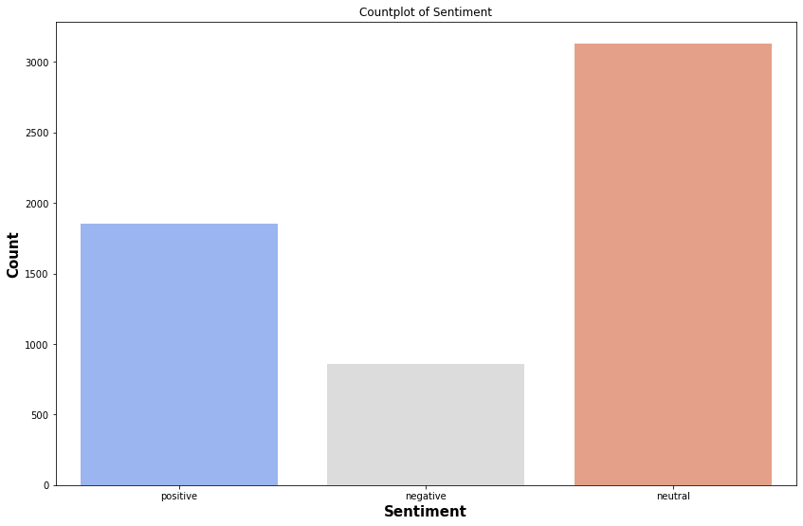

SENTIMENT COLUMN :

Slide 6
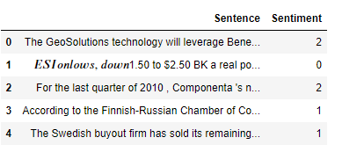
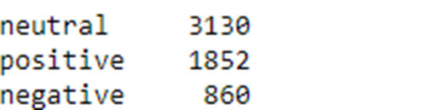

APPLYING LABEL ENCODING TO SENTIMENT COLUMN :

Slide 7
CLEANING THE SENTENCE :
STEPS :
Make the text lowercase. As you probably know, NLP is case-sensitive.
Remove line breaks. Again, depending on your source, you might have encoded line breaks.
Remove punctuation. This is using the string library. ...
Remove stop words using the NLTK library. ...
Removing numbers. ...
Stemming or Lemmatization (the process of reducing a word to its word stem)

Slide 8
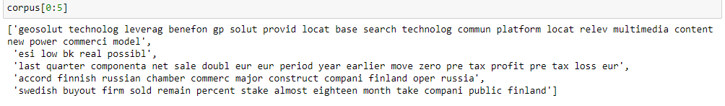
AFTER CLEANING THE SENTENCE :
Displayed five sentences here :

Slide 9
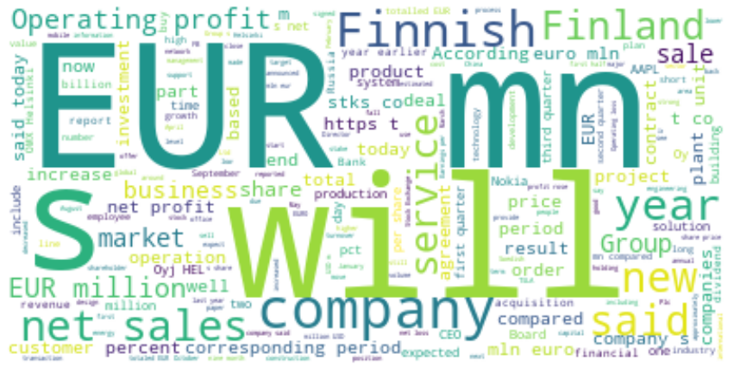
WORDCLOUD :

Slide 10
MODEL BUILDING :
NAÏVE BAYES MODEL :
Accuracy - 0.42
XGBOOST MODEL :
Accuracy - 0.68
SVM MODEL :
Accuracy - 0.67
LOGISITC REGRESSION MODEL :
Accuracy - 0.66

Slide 11

THANK YOU FOR VIEWING MY WORK !!

